Slide 1
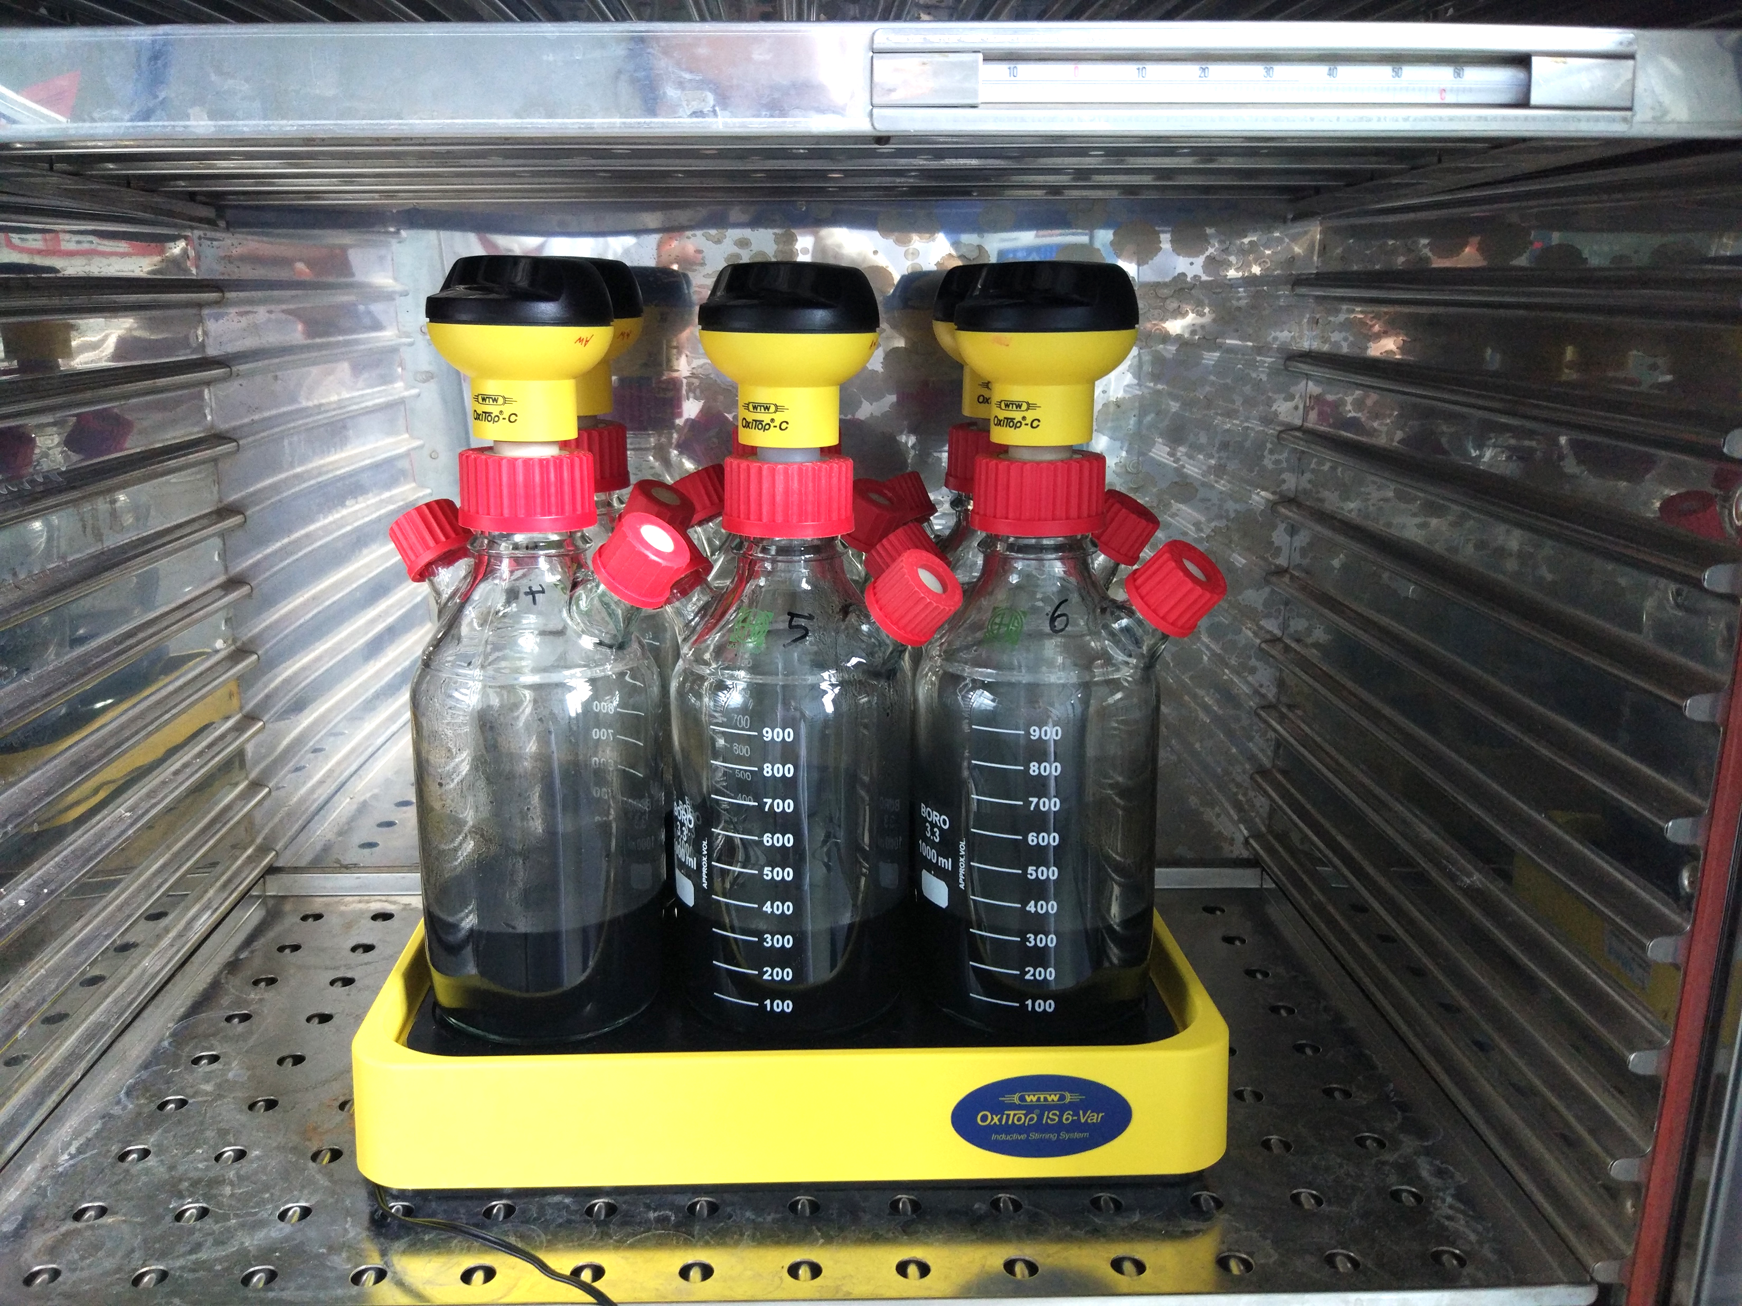
Concept Presentation for the Bachelor Thesis on The Biogas Potential of Sewage Sludge, Fermentation Residue, and Cow Manure
Alexandra Erfort
Environmental Engineering BSc, TU Berlin
17.05.2018

Slide 2
Outline
Introduction
Objective
Hypotheses
Materials and Methods
Expected Results
Time Schedule
Sources

Slide 3
1. Introduction
Research in context of the BioRist project:
Necessary data for current research regarding optimization of biogas yield from water hyacinths with rice straw and cow manure
Search for co-substrates to optimize the biogas yield in the pilot plant in Vietnam
Preparation for batch experiments
Need for a supplement for rice straw
Biogas potential of the inoculum on its own

Slide 4
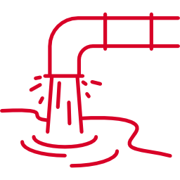


1. Introduction
Inocula:
Sewage sludge
Cow manure
Fermentation residue
“Product of wastewater treatment […] solid wastes are separated from the liquid wastes through settling […] processed and […] decomposed by bacteria” [2]
“Sludge or thickened mixture of sewage solids with water that has been decomposed by anaerobic bacteria” [3]
“Cow excreta used as fertilizer” [1]

Slide 5




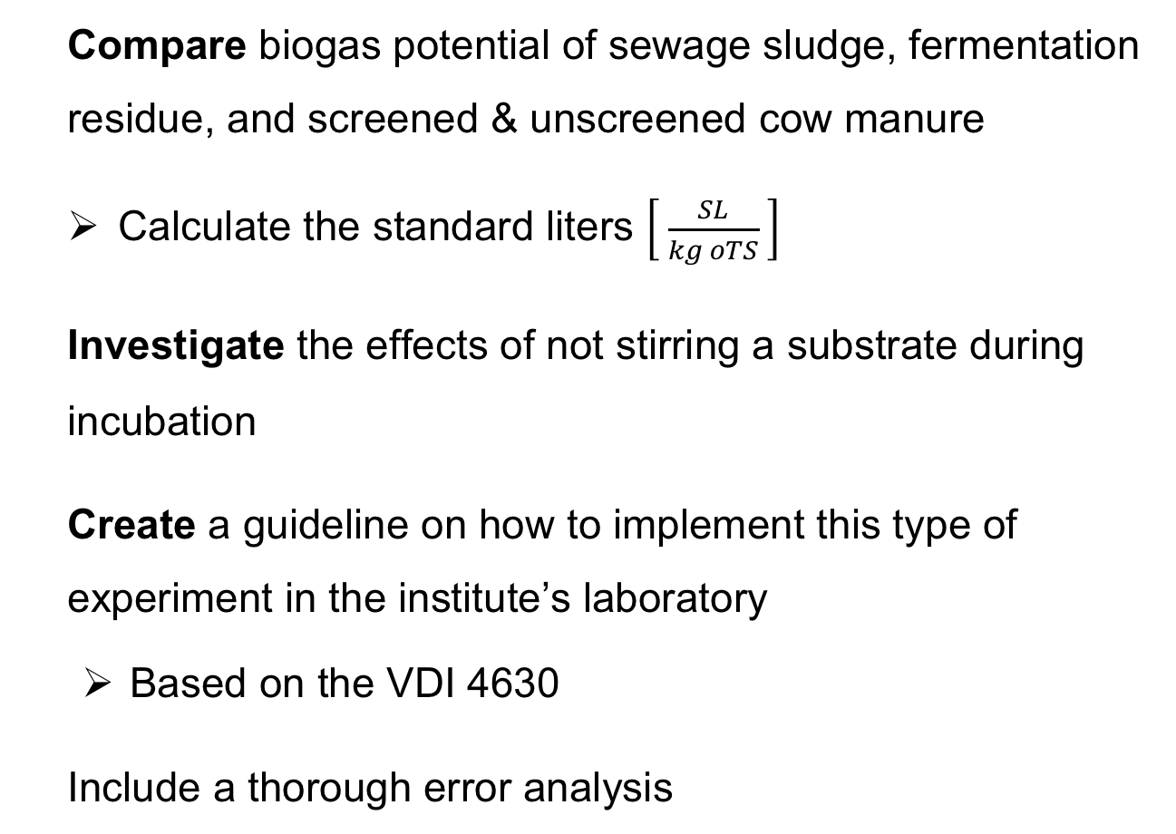
2. Objective
Compare biogas potential of sewage sludge, fermentation residue, and screened & unscreened cow manure
Calculate the standard liters $\left[ \frac{SL}{kg oTS} \right]$
Investigate the effects of not stirring a substrate during incubation
Create a guideline on how to implement this type of experiment in the institute’s laboratory
Based on the VDI 4630
Include a thorough error analysis

Slide 6
3. Hypotheses
Limited growth for all substrates and most growth within the first week of incubation
Original (unscreened) cow manure has a higher biogas yield than screened cow manure

Slide 7
4. Materials and Methods
Analyzed parameters: Dry matter, ignition loss and C/N (?)
Before and after incubation
Degassing with nitrogen → anaerobic environment
Incubation under mesophilic conditions (37 °C ± 2 °C) [5]
OxiTop one measurement every hour for two weeks

Slide 8
4. Materials and Methods
Limitations:
Magnetic Stirring Table
Limited to only six bottles simultaneously
Space for only two tests, since at least triple determinations should be conducted [5]
Maximum pressure for gas meter
Manual pressure release necessary
Notes:
→ especially in beginning need to release pressure

Slide 9


4. Materials and Methods
OxiTop Measuring Head
Pressure Release
OxiTop Controller
Inoculum
Stirring Flea

Slide 10
4. Materials and Methods
Inocula:
Sewage sludge
Cow manure
Fermentation residue
Fresh and stored
Screened and unscreened
Stirred and unstirred

Slide 11
4. Materials and Methods
Experiment | Inoculum
1st 2 weeks | 3x sewage sludge | 2x sewage sludge + 1 g cellulose | 1x sewage sludge + 2 g cellulose
2nd 2 weeks | 3x cow manure | 3x screened cow manure
3rd 2 weeks | 3x sewage sludge (4 weeks old)
4th 3 weeks | 3x fermentation residue | 3x fermentation residue, unstirred
Notes:
After 2 days took cellulose ones out of incubator over night and cancelled them completely after 5 days

Slide 12
4. Materials and Methods
Reasons for not-stirring:
Too much stirring might inhibit microorganisms and cause a drop of methane production [6]
Without active stirring, still slight mixing due to thermal convection flows and rising gas bubbles [7]
In general: short-term intensive stirring is more effective than long-term weak stirring [7]
Notes:
Usually not enough in biogas plants but may be enough for the small amounts we use in the lab

Slide 13
5. Expected Results
pressure
time

Slide 14
6. Time Schedule
 | April |  |  |  | May |  | June |  | July |  | August | Septem-ber
Literature research
Experiments
Data analysis
Interim Presentation |  |  |  |  |  |  | x
Writing
Final Presentation
x
Today

Slide 15
7. Sources
[1] | The Free Dictionary: Cow Manure. N.Y. [Access: 10.05.2018: https://www.thefreedictionary.com/cow+manure]
[2] | Center for Food Safety: What is Sewage Sludge? N.Y. [Access: 10.05.2018: https://www.centerforfoodsafety.org/issues/1050/sewage-sludge/what-is-sewage-sludge]
[3] | The Free Dictionary: Digested Sludge. N.Y. [Access: 10.05.2018: https://encyclopedia2.thefreedictionary.com/digested+sludge]
[4] | R. Zhang; H. El-Mashad: Biogas production from co-digestion of dairy manure and food waste. 2006. [Access: 09.05.2018: https://www.sciencedirect.com/science/article/pii/S0960852410000842]
[5] | Verein Deutscher Ingenieure: VDI 4630. 2016.

Slide 16
Sources
[6] | R. Kliche; M. Lebuhn: Bayern Biogas Forum: Schaum in Biogasanlagen. 2017. [Access: 09.05.2018. http://www.biogas-forum-bayern.de/media/files/0003/schaum-in-biogasanlagen.pdf].
[7] | H. Klußmann: Pump- und Rührtechnik in landwirtschaftlichen Biogasanlagen. N.Y. [Access: 09.05.2018. http://www.bfl-online.de/media/pump_und_%20ruehrtechnik_in_%20biogasanlagen.pdf].
[8] | Browne, J. et al.: The effects of storage time and temperature on biogas production from dairy cow slurry. 2014. [Access: 09.05.2018: https://ac.els-cdn.com/S1537511014001615/1-s2.0-S1537511014001615-main.pdf?_tid=d89c68a7-4800-489d-9c15-b92e3fc6d42e&acdnat=1525898666_12a46d6ec82740a8b5f6b48d10a99962]
Image source from slides 4, 5, 9 and 10: flaticon.com

Slide 17
Thank you for your attention! Any questions?

Slide 18
Additional Slides

Slide 19
Experimental Setup

Slide 20
What is new?
No studies on the comparison of stirred and not-stirred
No studies on the comparison of fresh and stored sewage sludge
Only on slurry, where it had almost no effect [8]
Not a lot on the effects of screening the manure
“Based on mass balance calculations, separation of the coarse fraction of manure would sacrifice about 32 % of the energy potential” [4]

Slide 21
Further Hypotheses
Order of biogas yield for the different substrates:
Original Cow Manure > Screened Cow Manure > Fermentation Residue = Unstirred Fermentation Residue > Fresh Sewage Sludge > Stored Sewage Sludge
Not-stirred substrate is similar to stirred substrate regarding the yield of biogas

Slide 22
First Results

Slide 23
First Results
 | TS | oTS
Pre-incubation | 2.1 % | 63.6 %
Post-incubation | 2.0 % | 60.3 %

Slide 24
Outline for Thesis
Introduction
Motivation
Goal & hypotheses
Background
Biogas: anaerobic digestion
Sewage sludge, fermentation residue and cow manure
VDI 4630
Material
Sewage Sludge (fresh, stored)
Fermentation Residue (stirred, not stirred)
Cow Manure (screened, unscreened)
Methods
Literature research
Substrates analyses
Dry matter
Ignition loss
C, N, S
Instructions for incubation according to VDI 4630
Results
Literature results
Substrate Parameters
Incubation results
Resulting Biogas production rate
Comparison of different inocula
Sewage sludge: fresh and stored
Fermentation residue: stirred and not stirred
Cow manure: screened and not screened
Discussion
Biogas production rate
Comparison of all six different inocula
VDI 4630
Error analysis
Conclusion
Hypotheses answered?
Further Research Demand
Practicability for Vietnam

